Slide 1
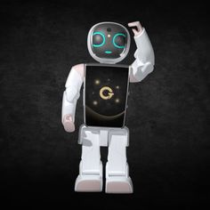
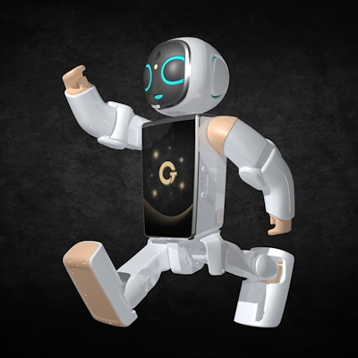
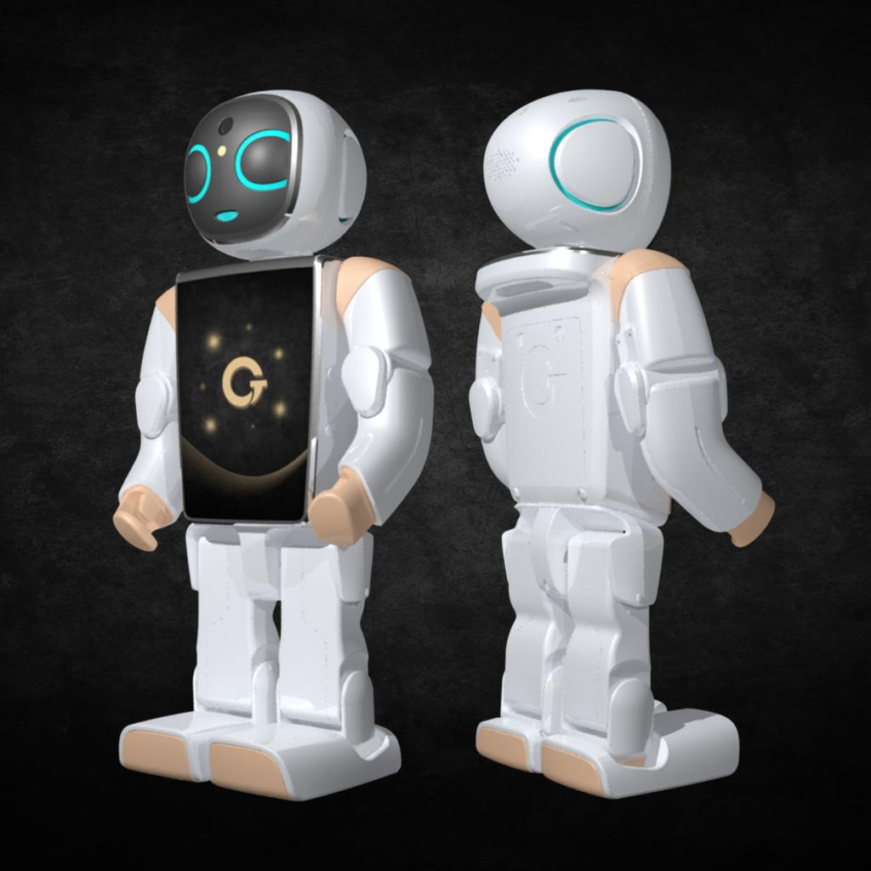
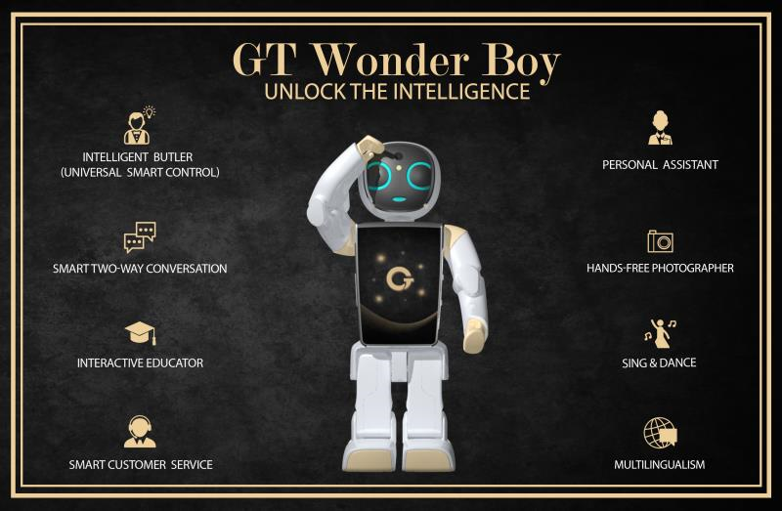
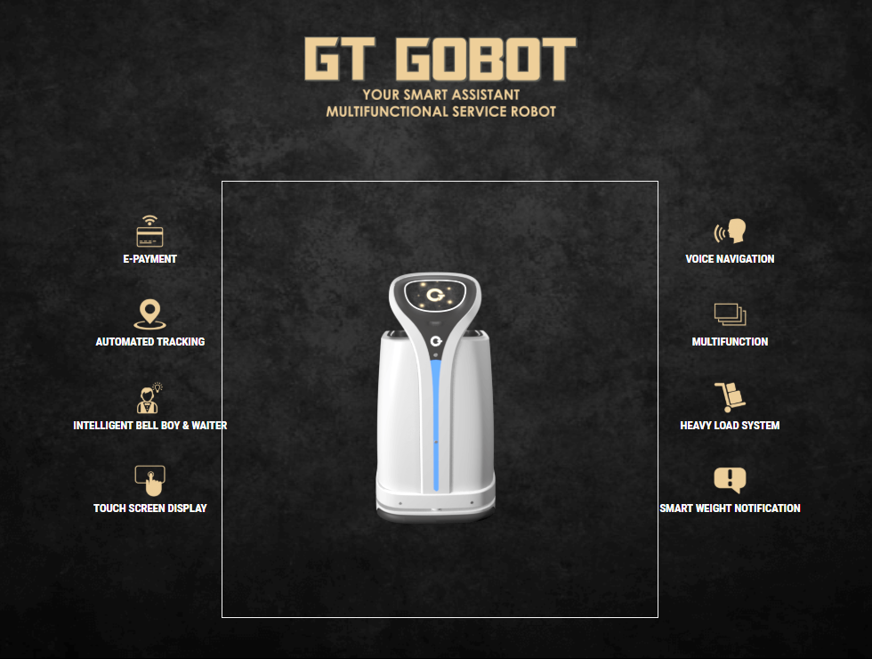
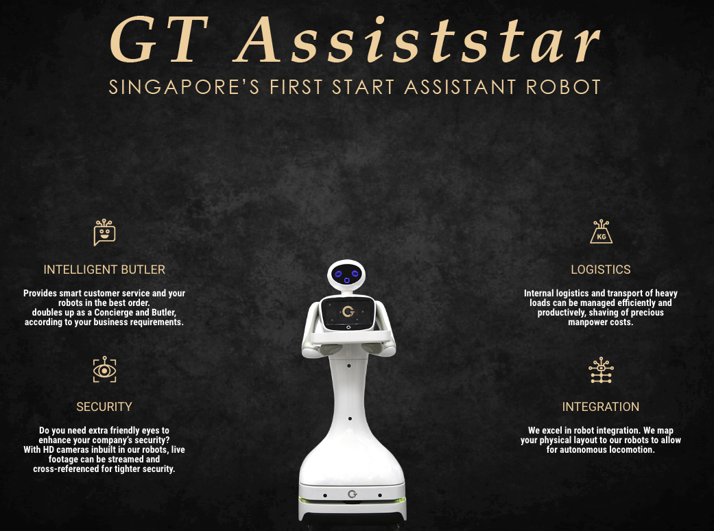
Slideshow
- Change-able
- Possible to add text inside corners

Slide 2
Enlarged Image

Slide 3
Enlarged Image

Slide 4
Enlarged Image

Slide 5

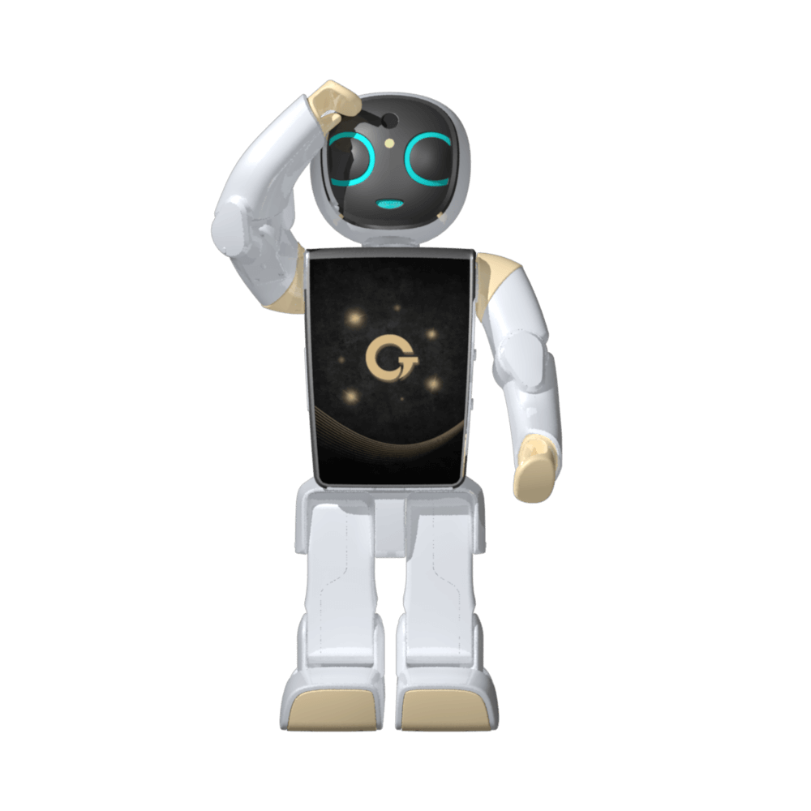

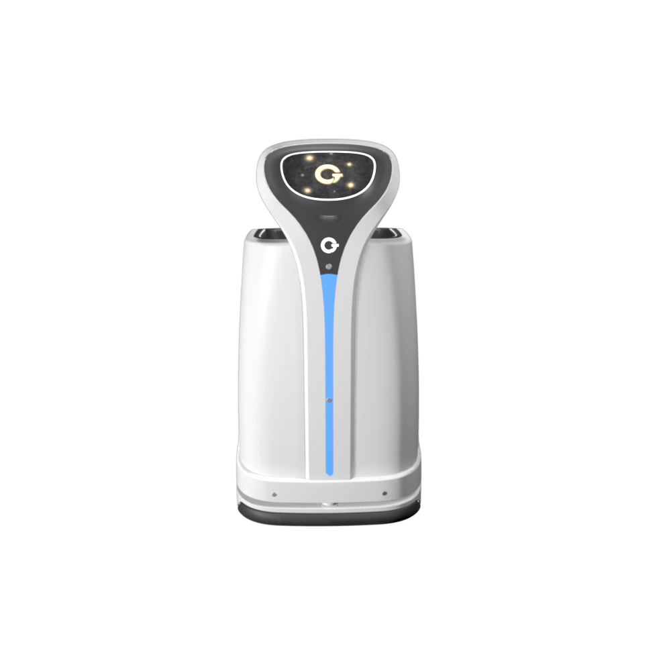
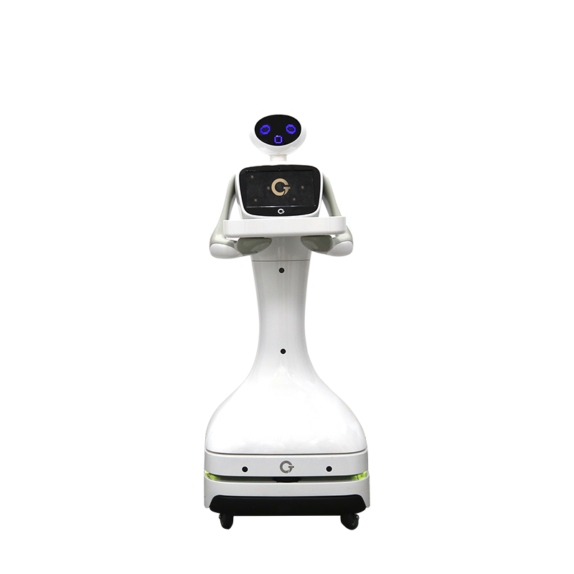


Sample
- Changeable and editable
- Both image and text
- Number of slides
- Possible to add text inside corners
- Custom slideshows might have to hard-code

Slide 6
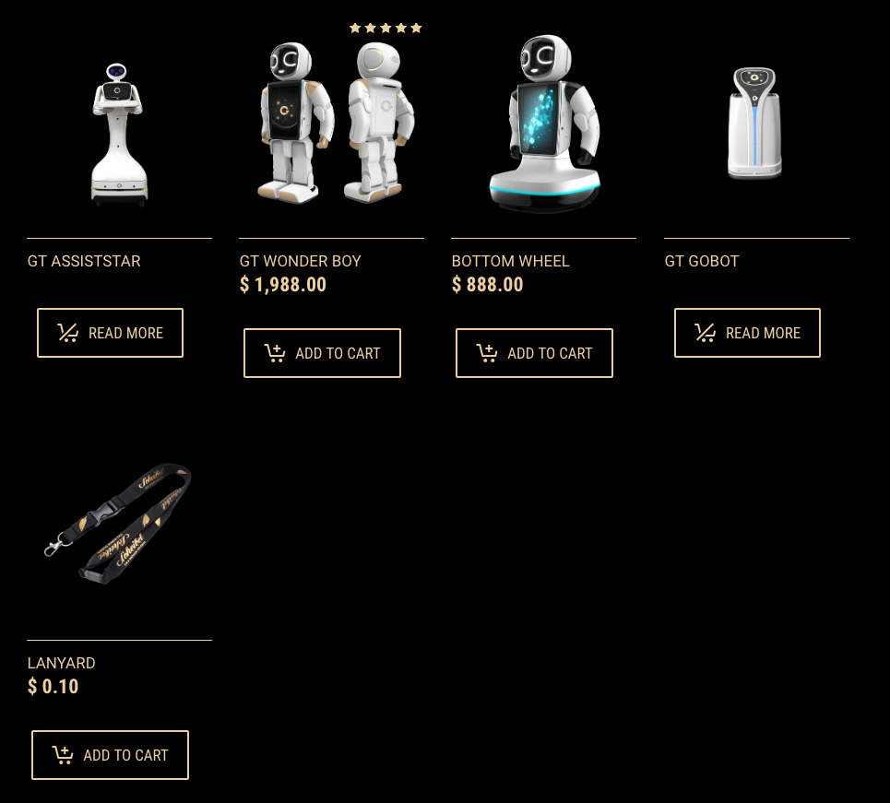
Products Sold Currently

Slide 7

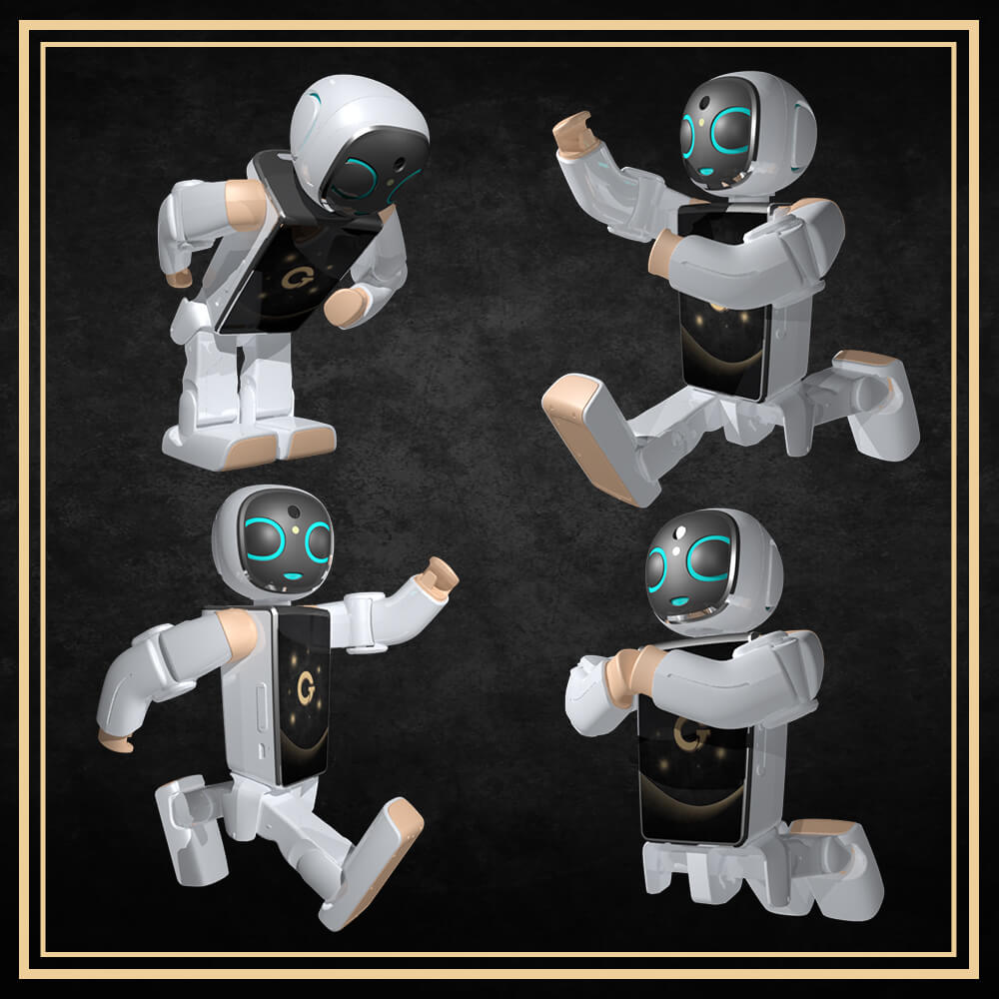
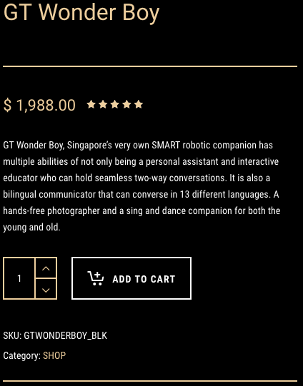
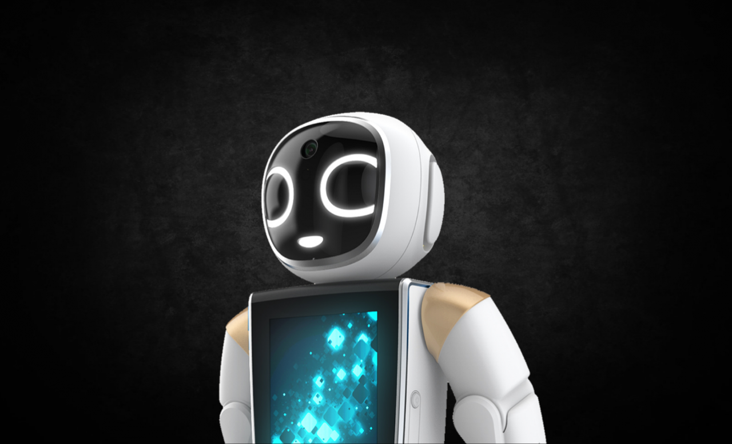
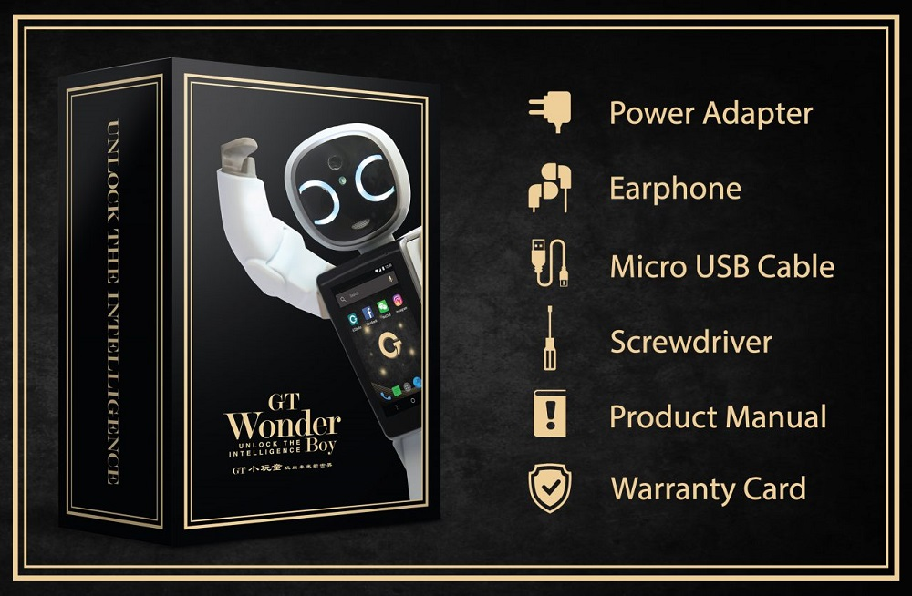


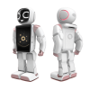
Product Description
Additional Description:
It also supports the main functions of a smartphone including e-wallet, e-map, virtual credit clearance, video conferencing, Internet calls, translation, order management and an extensive search option over 80 million merchants worldwide. GT Wonder Boy is a lightweight companion that has a surround sound system paired with LED lights for the eyes and ears for a sensory user experience.
Adopting a mainstream smartphone configuration, equipped with a quad-core processor, 3GB of memory, 13 megapixels camera resolution and 5000 mAh batteries with a battery life of up to 48 hours. It sure is a highly durable mobile companion.
GT Wonder Boy continues to revolutionise the international market with its artificial intelligence, which was launched this year. GT Wonder Boy is an intelligent social bot that adapts to the user’s habits providing a personalised user experience.
GT Wonder Boy is no stranger to the media after making multiple headlines on prominent foreign media such as BBC World News, The Straits Times, China Central Television, Malaysia Gazette, Bernama News Channel, Malay Mail and TV 1 News.
Yellow
Blue
Pink

Slide 8
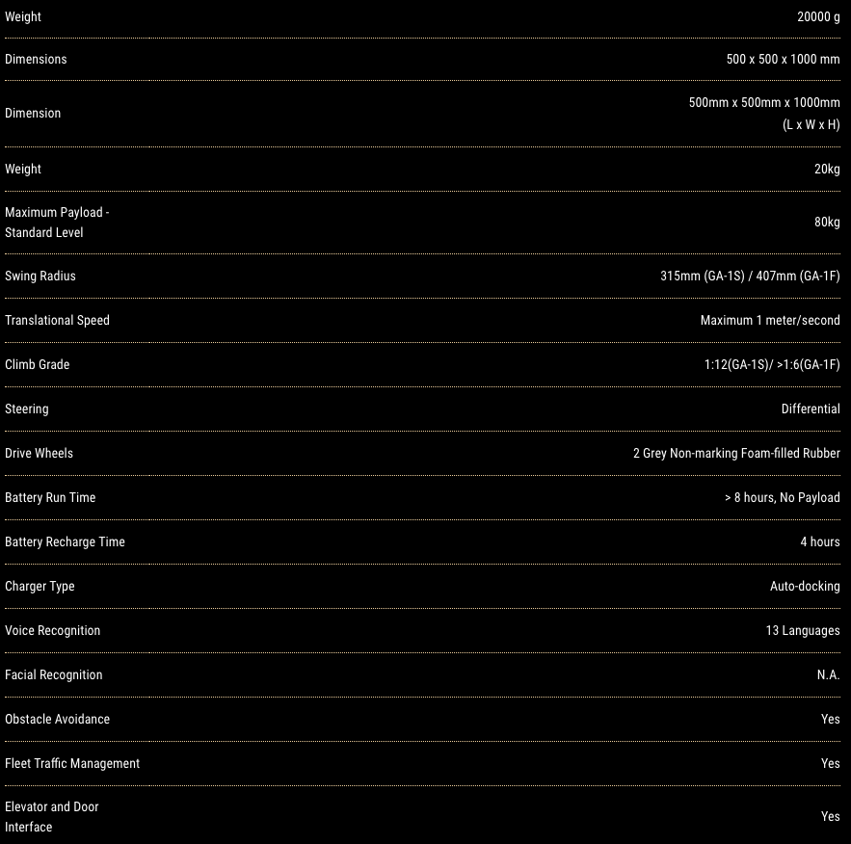
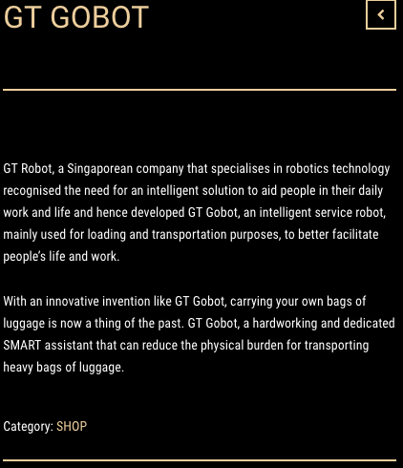
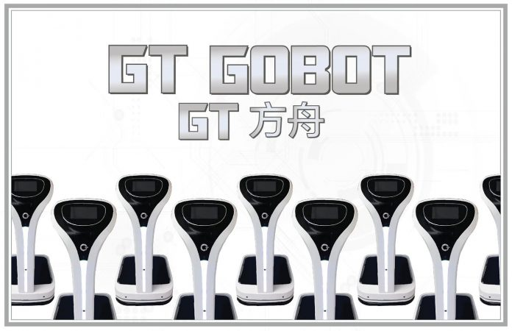
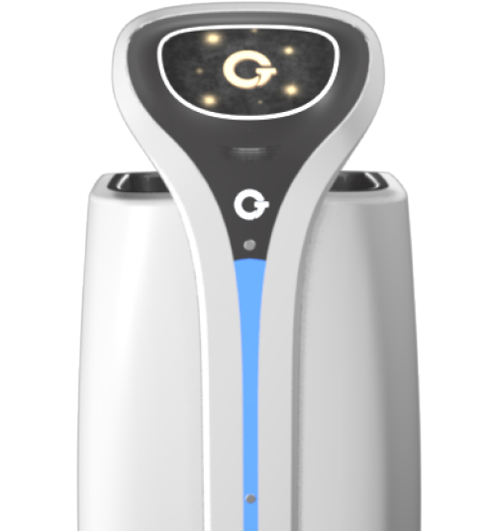
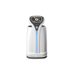


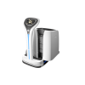
Your Intelligent Bell Boy & Waiter
Often we find ourselves busy while hosting dinner parties and probably forgetting something important. What do you do if you suddenly realise you forgot to get a bottle of wine but yet you can’t leave your doorstep as guests are arriving soon? Well with seamless voice commands, GT Gobot can now instantly do quick, reliable, online purchases via it’s e-wallet system.
Designed for SMART automated movements to reach designated place with the ability to avoid obstacles along the route. It is a safe and hassle free SMART invention. GT Gobot can also be used in a restaurant setting where it can serve food and drinks to diners efficiently in the midst of a crowd.
In addition to the above key features, it has other specific functionalities such as a robust outlook measuring a total of 0.6 meters in length, 0.5 meters wide and 0.9 meters high. With the ability to sustain a load of up to 50kg, traveling at a speed of 20-30 meters per minute. Equipped with laser radar and other sensors, real-time map building and positioning capabilities, along with obstacle avoidance algorithm, capable of autonomous navigation in complex environments.
Product Description
Smart Voice Navigation & Weight Notification
With voice control and electronic screen control as the main form of navigation, it supports communication between user and bot, enhancing users sensory experience. The height of the electronic display can be adjusted in accordance to the user’s preferences for capacitive sensing.
Also equipped with a smart weight notification, it automatically detects a change in weight should an item accidentally drop off in the midst of transportation.
In a globalized world, where convenience and efficiency is key to keep up with the fast pace lifestyle. GT Robot is steadily growing and trying to come up with SMART solutions to improve efficiency, promote safety and provide entertainment to improve the overall quality of people’s lives, transitioning into the intelligence era.

Slide 9

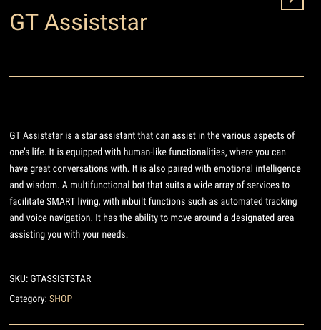
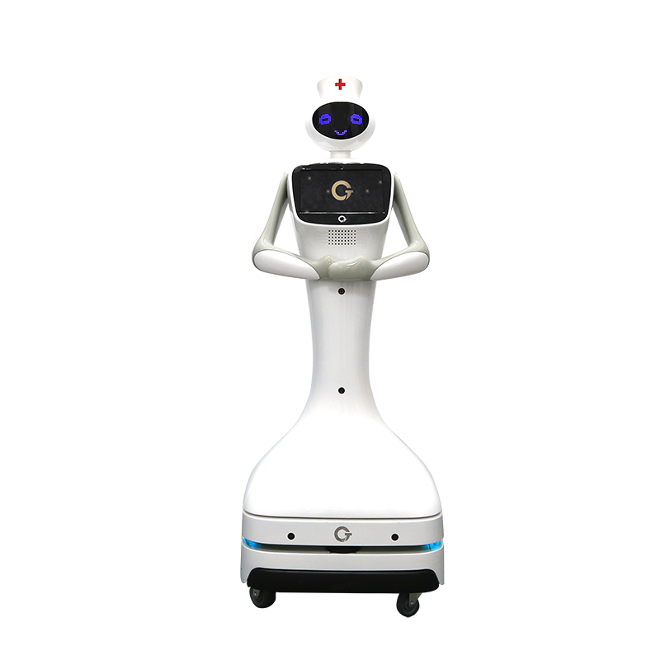
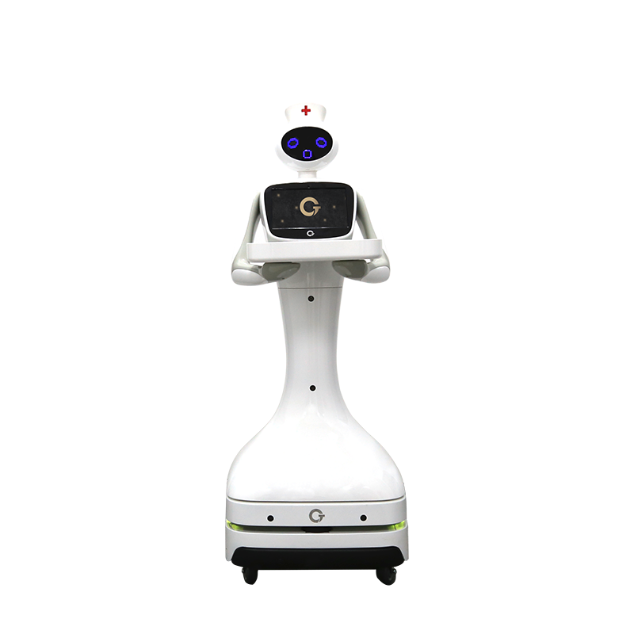
Product Description

Slide 10
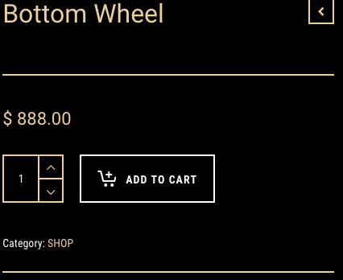
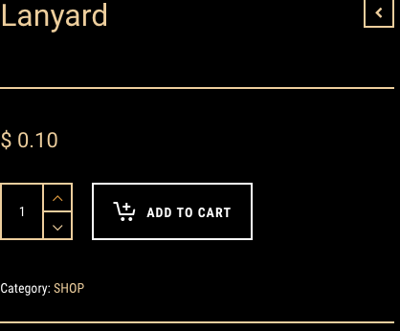
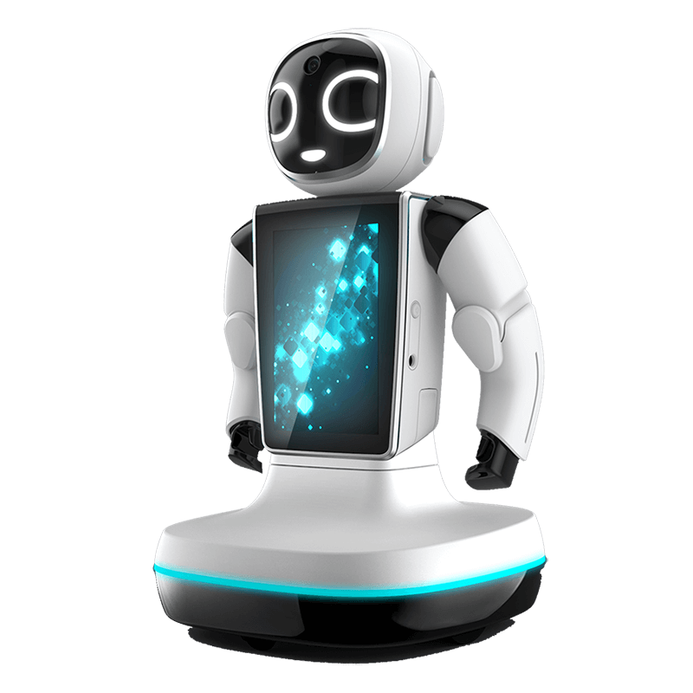
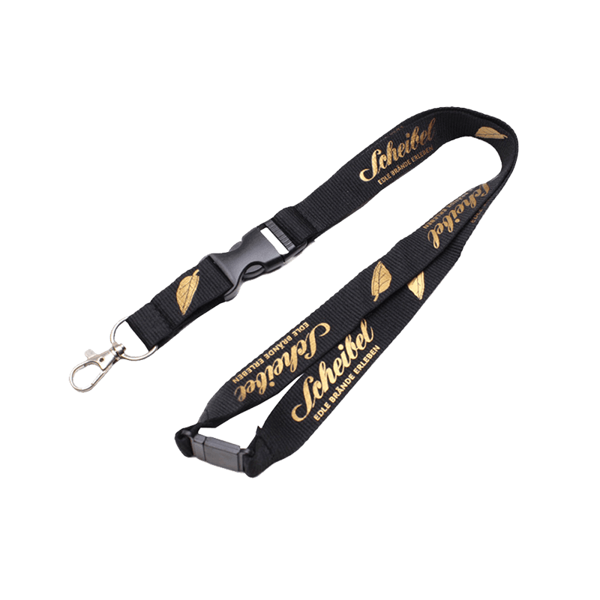
Product Description

